Slide 1
An Examination of Socio-demographic Differences in Sedentary Behavior
Liming Huang

Slide 2
Background
Sedentary behavior is any waking activity characterized by an energy expenditure ≤ 1.5 metabolic equivalents and a sitting or reclining posture.
It might be associated with cardiovascular disease, obesity, mental health, cancer, all-cause mortality, etc.
Physical activity guidelines usually do not include sedentary behavior.
Further evidence is needed to develop guidelines on sedentary behavior.

Slide 3
Research question
Are there socio-demographic differences in sedentary behavior?
What is the socio-demographic profile of high sedentary behavior?

Slide 4
Data
Extracted from the UK Biobank cohort study baseline data
Analytic sample size N=100,423
3 sedentary behavior metrics: TV_HRS, COMP_HRS, DRIVE_HRS
8 socio-demographic characteristics: AGE, GENDER, RACE, COLLEGE, EMPLOYMENT, SHIFT_WORK, RESIDENCE, DEPRESSION, and SEASON_ASSESS

Slide 5
Methods
ANOVA for association between discrete variables and sedentary behavior
Zero-inflated Poisson regression for association between age and sedentary behavior
Regression tree for socio-demographic profile of high sedentary behavior

Slide 6
Results
1. Exploratory analysis of socio-demographic characteristics
2. Exploratory analysis of sedentary behavior
3. Socio-demographic differences in sedentary behavior
4. Socio-demographic profile for high sedentary behavior

Slide 7
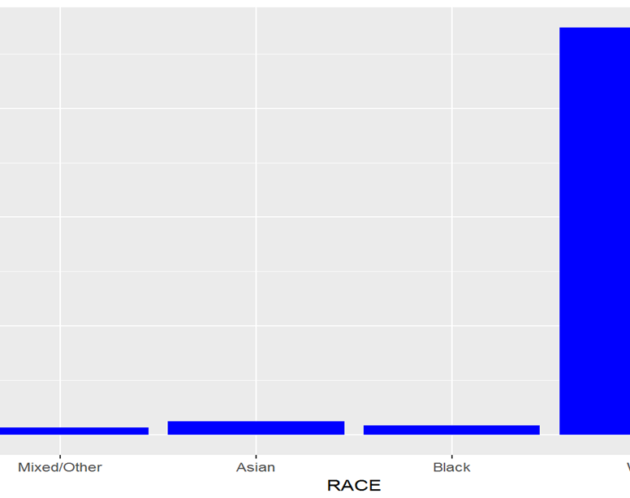
Race
Mixed/Other Asian Black White
0.016 0.031 0.022 0.93

Slide 8
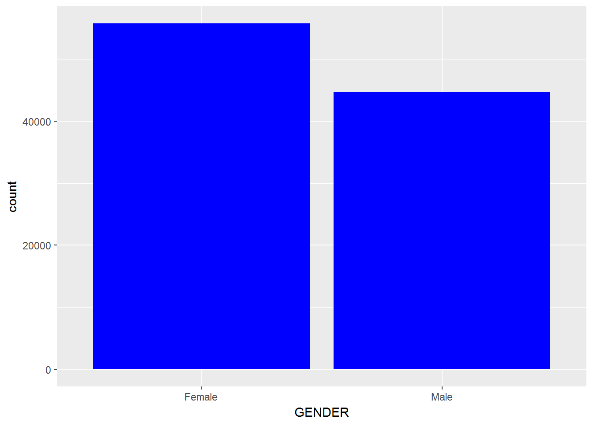
Gender
Female Male
0.56 0.44

Slide 9
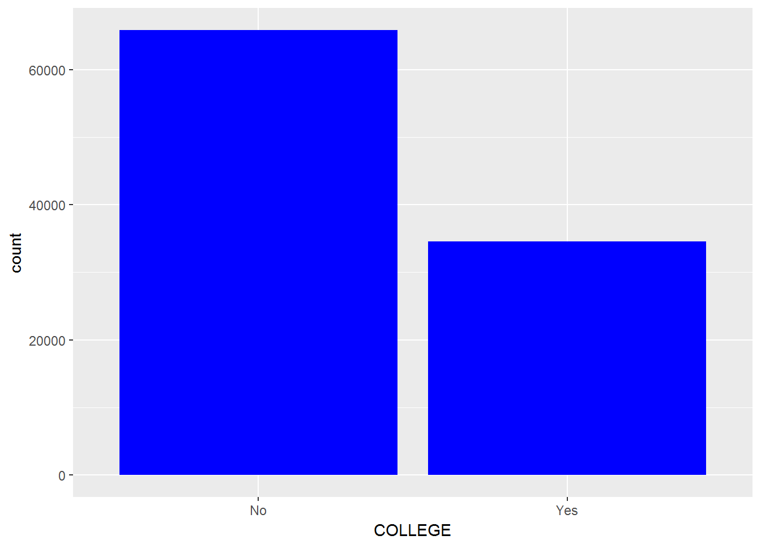
College
No Yes
0.66 0.34

Slide 10
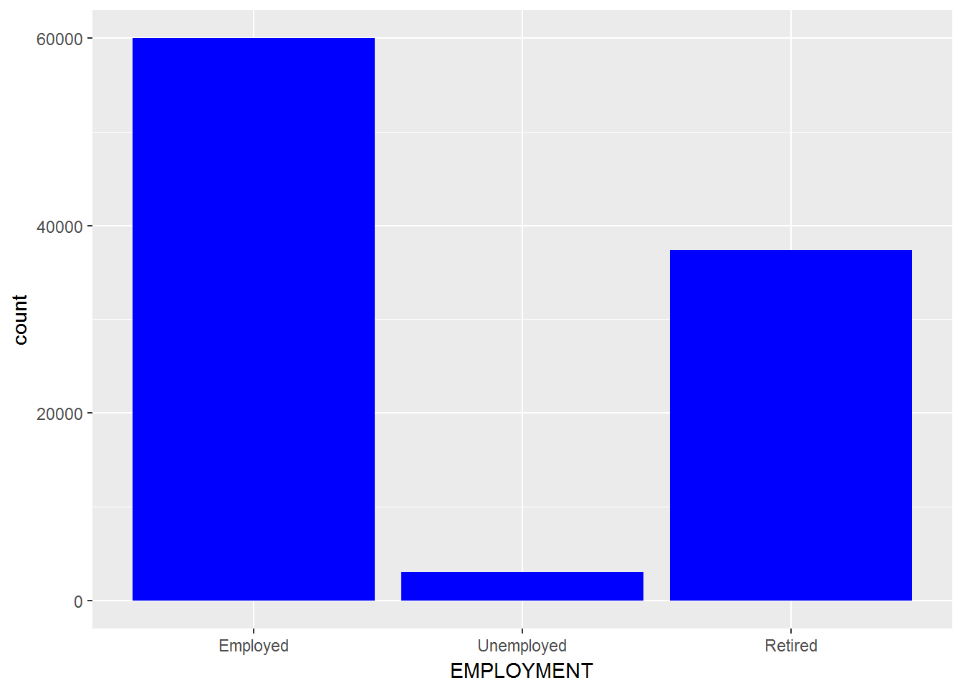
Employment
Employed Unemployed Retired
0.60 0.03 0.37

Slide 11
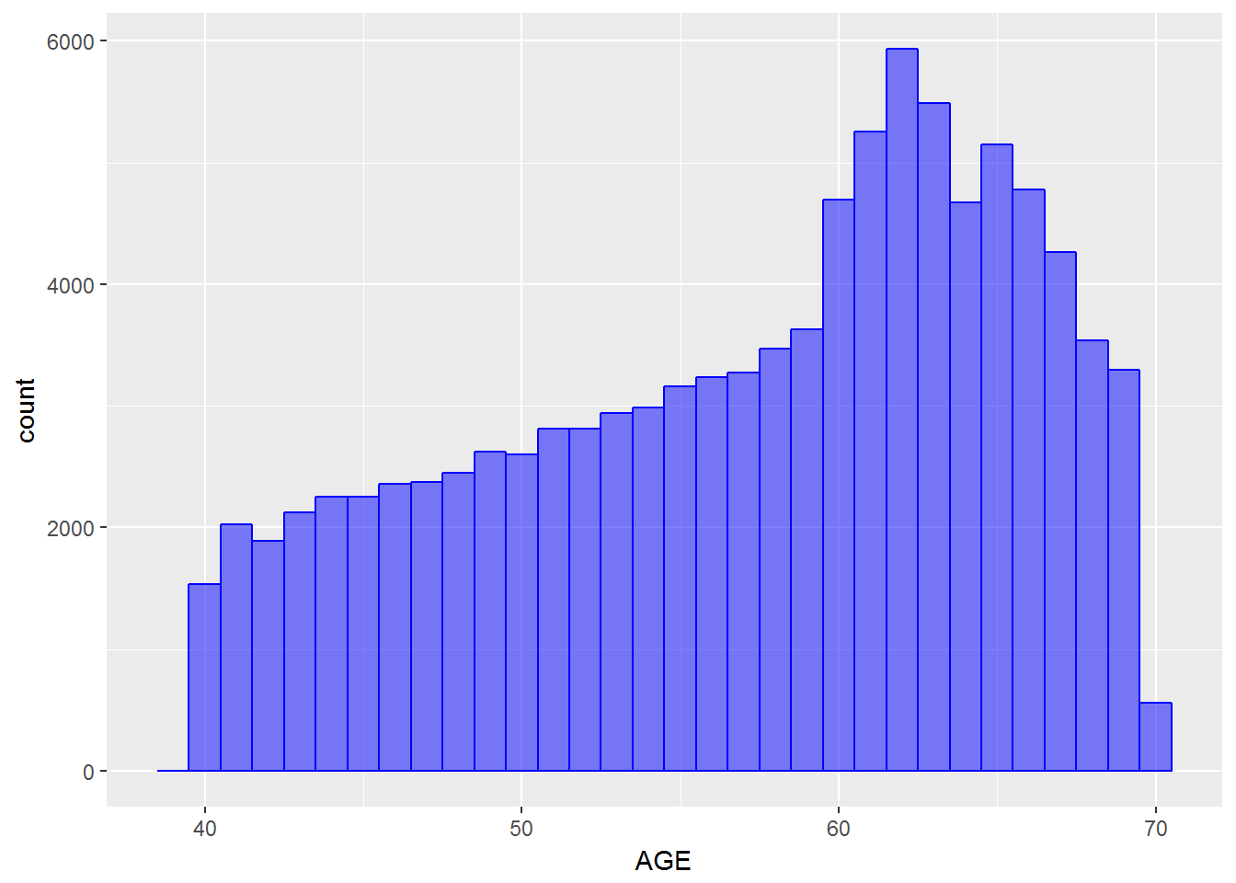
Age
Mean 57
SD 8.13
Min 39
Max 70
Median 59

Slide 12
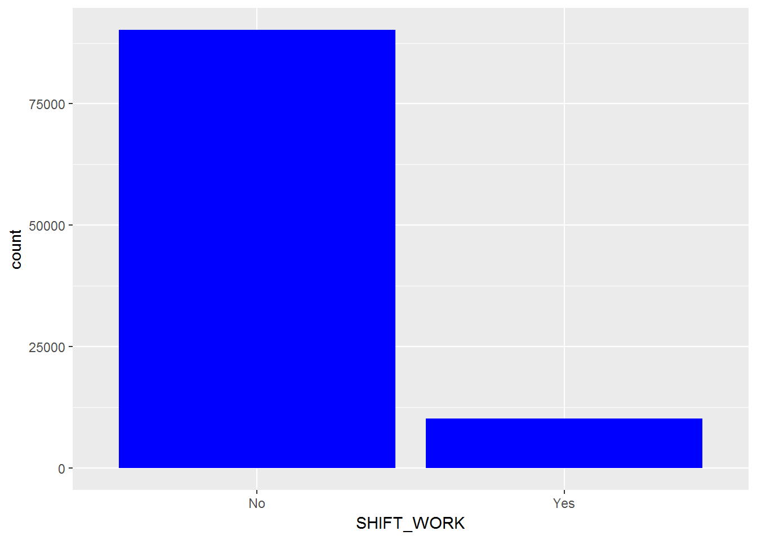
Shift work
No Yes
0.90 0.10

Slide 13
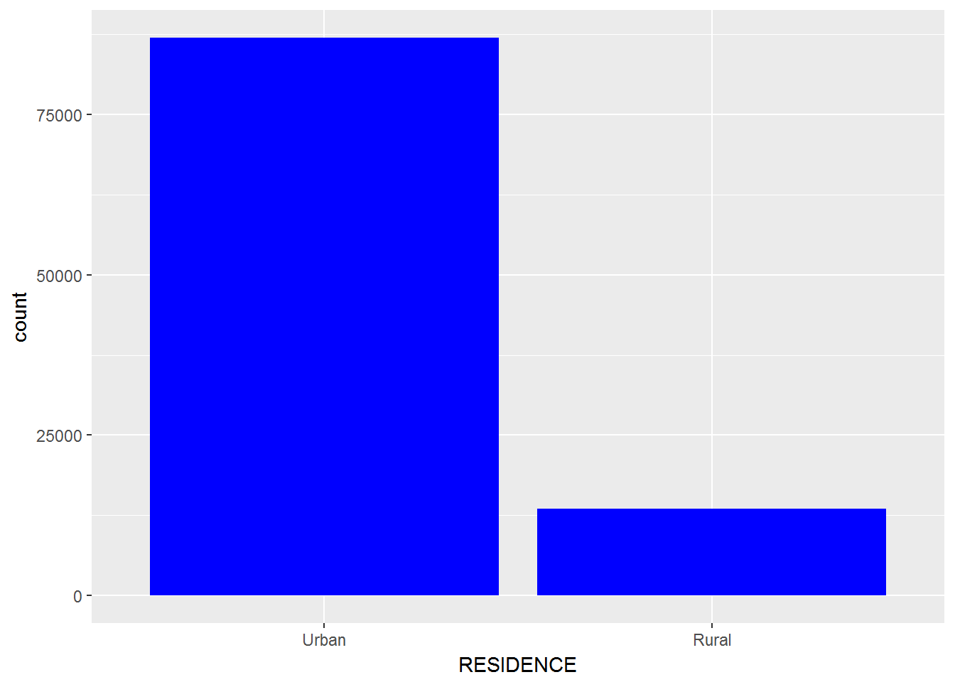
Residence
Urban Rural
0.87 0.13

Slide 14
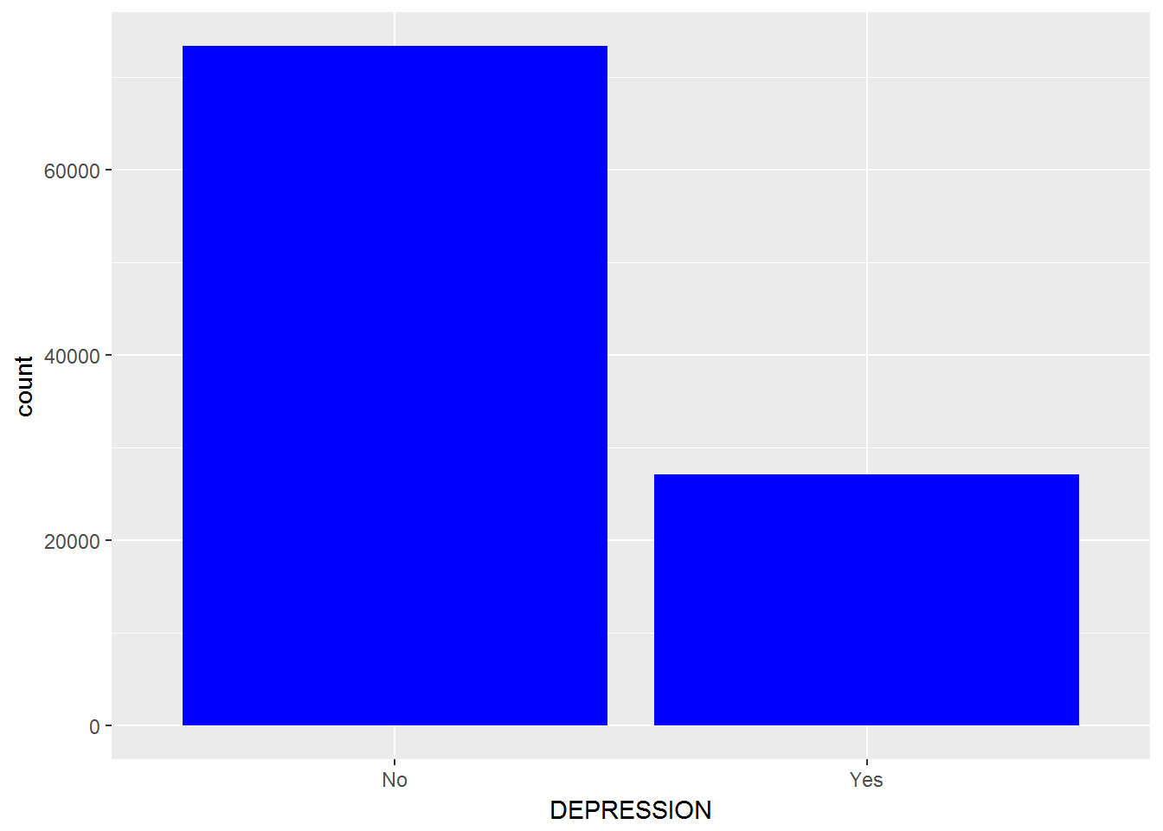
Depression
No Yes
0.73 0.27

Slide 15
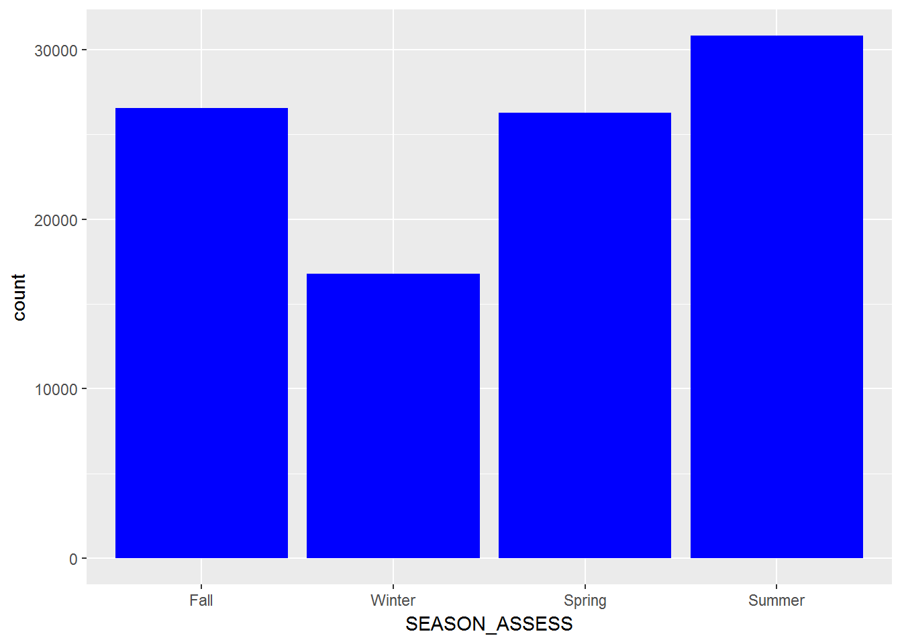
Season of assessment
Fall Winter Spring Summer
0.26 0.17 0.26 0.31

Slide 16
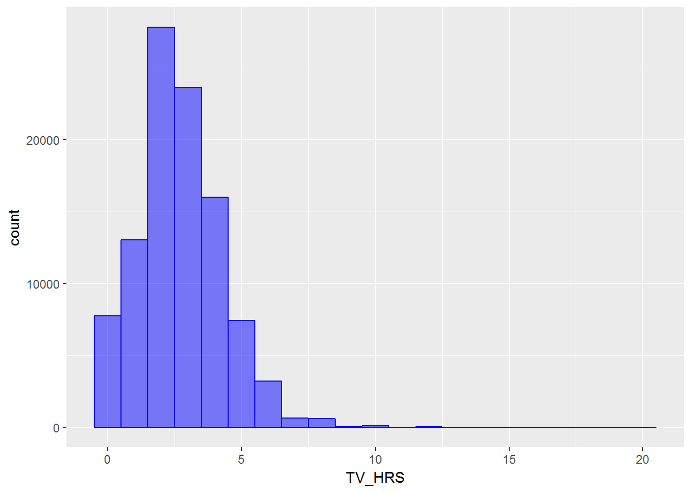
Daily hours of TV viewing
Mean 2.73
SD 1.57
Min 0
Max 20
Median 3

Slide 17
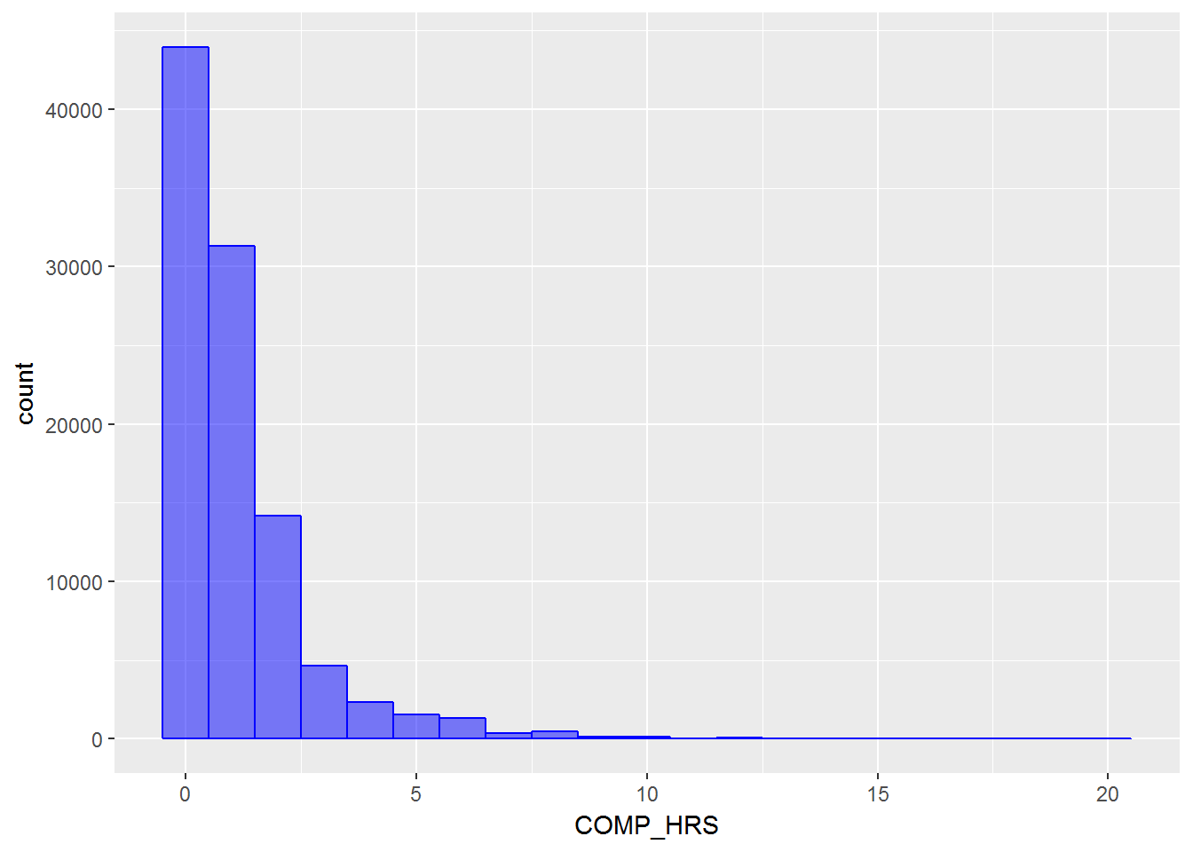
Daily hours of recreational computer use
Mean 1.18
SD 1.57
Min 0
Max 20
Median 1.42

Slide 18
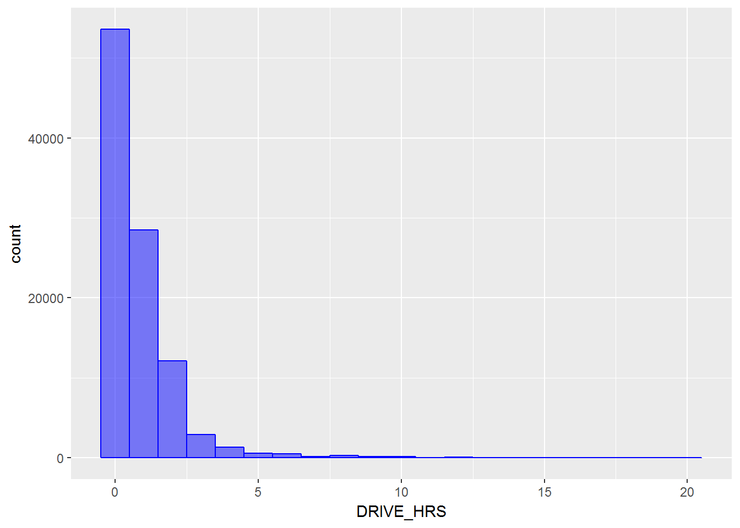
Daily hours of driving
Mean 0.80
SD 1.27
Min 0
Max 20
Median 0

Slide 19
Daily TV watching
Males spent 0.02 hours more than females (p=0.08)
Blacks 0.18 hours more than whites and 0.54 hours more than asians (all p<0.0001)
Retired participants 0.54 hours more than the unemployed and 0.83 hours more than the employed (all p<0.0001)
Those who did not attend college 0.88 hours more than college attendees (p<0.0001)
Those with regular work 0.15 hours more than shift workers (p<0.0001)
Urban residents 0.15 hours more than rural residents (p<0.0001)
In winter time spent watching TV was 0.06 hours more than in spring, 0.10 hours more than in fall, and 0.15 hours more than in summer (all p<0.0003)
The daily hours of TV viewing increased by 1.53% with one year increase in age (p<0.0001)

Slide 20
Daily recreational computer use
Males spent 0.36 hours more than females (p<0.0001)
Blacks 0.18 hours more than asians and 0.48 hours more than whites (all p<0.0001)
The employed 0.14 hours more than the unemployed and 0.19 hours more than the retired (all p<0.0001)
College attendees 0.44 hours more than those who did not attend college (p<0.0001)
Shift workers 0.04 hours more than those with regular work (p=0.02)
Urban residents 0.11 hours more than rural residents (p<0.0001)
People with depression 0.09 hours more than those without depression (p<0.0001)
In spring time spent using computer was 0.08 hours more than in fall, 0.09 hours more than in summer (all p<0.0001), but not significantly different from that in winter
The daily hours of recreational computer use decreased by 0.30% with one year increase in age (p<0.0001)

Slide 21
Daily driving
Males spent 0.50 hours more than females (p<0.0001)
Blacks 0.26 hours more than Asians and 0.42 hours more than whites (all p<0.0001)
The employed 0.52 hours more than the unemployed and 0.60 hours more than the retired (all p<0.003)
Those who did not attend college 0.22 hours more than college attendees (p<0.0001)
Shift workers 0.70 hours more than those with regular work (p<0.0001)
Rural residents 0.14 hours more than urban residents (p<0.0001)
Those without depression 0.02 hours more than people with depression (p=0.013)
Driving hours did not differ significantly across seasons
Daily hours of driving decreased by 2.2% with one year increase in age (p<0.0001)

Slide 22
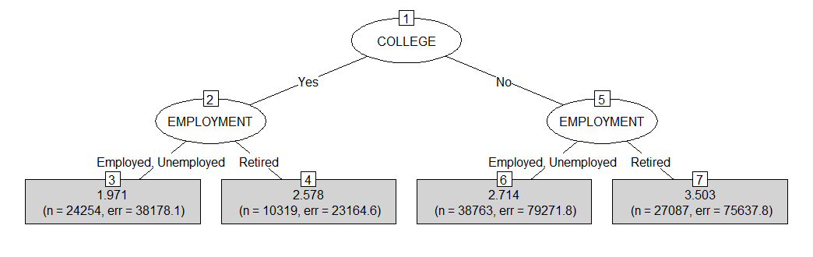
Daily TV Viewing

Slide 23
Daily TV viewing
Education and employment status are the most predictive factors
Not attending college (tier 1) and being retired (tier 2) accumulated the highest mean daily hours of television viewing (M=3.50) versus the 1.98 mean hours reported by college attendees who were employed or unemployed
R-squared = 0.123

Slide 24
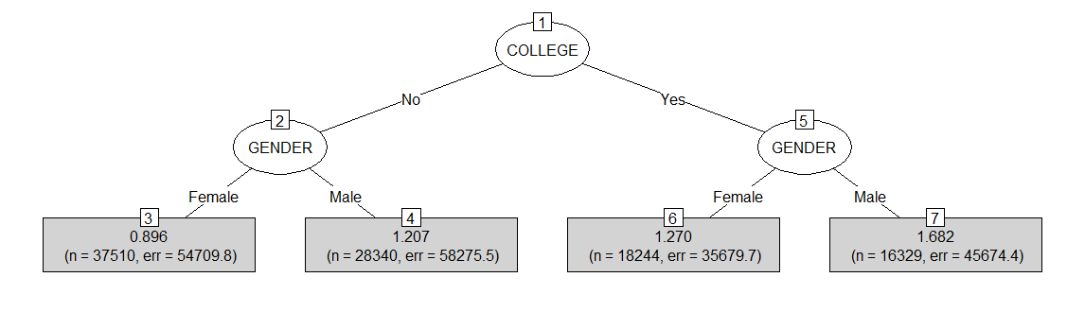
Daily recreational computer use

Slide 25
Daily recreational computer use
Education and gender were the two most important factors
Male college graduates averaged 1.682 hours per day versus the 0.896 hours recorded by female non-college graduates
R squared = 0.036

Slide 26
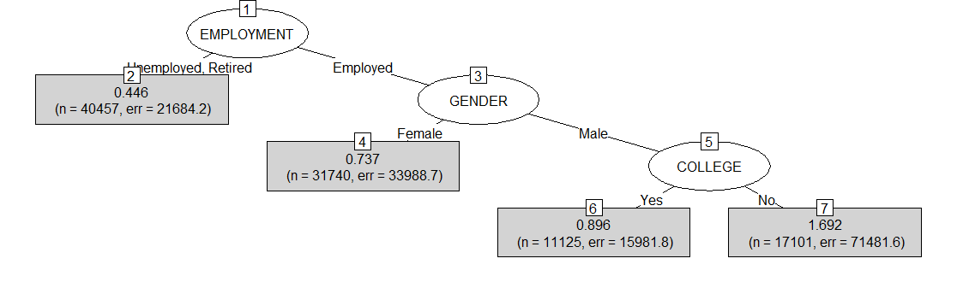
Daily driving

Slide 27
Daily driving
Employment status, gender, and education were the three most predictive factors
Being employed (tier 1), male (tier 2) and not attending college (tier 3) distinguished the highest mean daily hours of driving (M=1.69) versus the 0.446 mean hours reported by unemployed or retired participants
R squared = 0.117

Slide 28
Conclusion
Sedentary behavior has multi-dimensional nature
Sedentary behavior varies by socio-demographic characteristics
For different sedentary behavior, the most predictive socio-demographic profile for higher sedentary behavior participation is different

